Slide 1






User Accounts
in Linux

Slide 2

TABLE OF CONTENTS
01
Introduction
04
Admin & Guest
02
Create/Delete Accounts
05
Required Password Change
03
Account Permissions
& Activity
06
Quiz

Slide 3

Creating Accounts
Blue = Type this in terminal
Purple = formula
You can also view the next slide for what the terminal will look like with these commands!
Steps:
See if you have sudo/admin privilleges
sudo –V
The general format for this will be:
useradd [options] USERNAME
-d lets you specify a home directory for user
-e lets you set an expiration date
-G lets you assign a group to user
sudo useradd newuser
For the username, you
have a 32 character
limit in Linux
For this, we will be using the useradd command in Linux. There is another command that is similar called adduser, real creative here. The difference between the two is that adduser is usually for more experienced Linux users who are also using Debian based virtual machines. Adduser is highly customizable and something to do some independent research on after this lesson!
The files useradd interacts with are:
/etc/shadow, /etc/password, and /etc/group

Slide 4
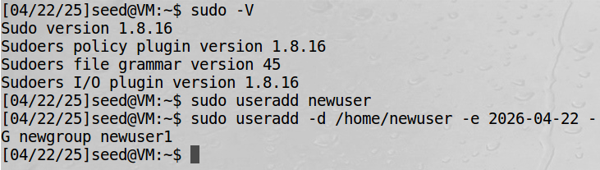
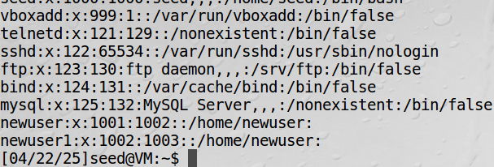
Creating Accounts
When you run sudo –V, it will print the version of sudo that you have, which means that you do have sudo privileges! The top picture shows the basic useradd format along with an example of what it looks like to use the flags for the command.
For the second command, newuser1's home directory is set to /home/newuser, their account will expire on April 22, 2026, and they were added to the group called newgroup.
Once you have added a user, you might want to double check that the user actually exists. To do this, you can run
cat /etc/passwd. Your
new users will normally
be at the bottom, but not
always!

Slide 5
Blue = Type this in terminal
Purple = formula
You can also view the next slide to see what the terminal will look like with these commands!
Steps:
See if you have sudo/admin privileges
sudo –V
The general format for this will be:
userdel [options] username
***Bonus Info***
-r removes a users home
directory where the r
stands for "recursive"
Deleting Accounts
For deleting users, we will be using the userdel command. This is just shorthand for "user + delete".
You must be very careful when you decide to delete a user because you will not be able to take it back or recover files related to that user when using –r (deleting the users home directory).

Slide 6
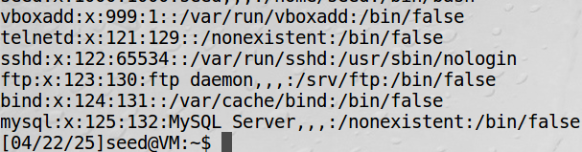
Deleting Accounts
Running the userdel command is simple.
It will not return anything, so if you want to ensure that the user got deleted, you can check back with cat /etc/passwd. You should see that the users are no longer listed there.

Slide 7

Account Permissions
Account Permissions can be broken down into 3 main components:
01
R: Stands for read
Allows a user to read the contents of a file
02
W: Stands for Write
Allows a user to modify a file
03
X: Stands for Execute
This allows a user to execute a file

Slide 8



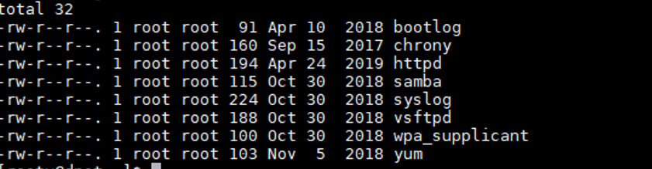


Account Permissions
Now what do these look like in practice? If you run ls –l /etc, you might see a bunch of text that looks like this:
Permissions are separated into 3 sections: Owner, Group, and Others
If there is a '-', then that group does not have that permission. In this example, all the permissions are the same. Owners all have read and write while group and others only have access to read.

Slide 9



Account Permissions
How do we change account permissions in Linux? Simple!
There are 3 popular commands, but each have their differences:
chmod
chown
chgrp
This command modifies the permissions of the file/directory
This command changes the owner of the file
This command changes the group ownership of a file

Slide 10
Account Permissions
Account permissions can be translated into numbers. To translate, we use the binary counting system. Each number is a place holder that stands for: Read, Write, and Execute
1 1 1
7 is this groups permission value, which means that has Read, Write, and Execute
Value: 4 2 1
Total: 4 + 2 + 1 = 7

Slide 11
Account Permissions
Let’s try another one!
0 1 1
3 is this groups permission value, which means that has Write and Execute, but no read permissions
Value: 4 2 1
Total: 0 + 2 + 1 = 3

Slide 12
Account Permissions
Activity:
Try it out on your own! The answers are on the next slide.
101 = ?
110 = ?
001 = ?
010 = ?
100 = ?

Slide 13
Account Permissions Activity
Here’s the answers! How did you do?
101 = 5
110 = 6
001 = 1
010 = 2
100 = 4

Slide 14
Account Permissions
Remember! Account permissions are grouped in 3 permissions per group (3). So, when we are changing the permissions to a file/directory, there will be 3 binary digits associated with it. For example, take a look at the following permission:
6 5 7
This permission is set to where the owners have read and write, the group has read and execute, and the others have read write and execute.

Slide 15
Account Permissions
Let’s break that down really quick before we get into some more example problems!
6 5 7
A ‘-’ in the permissions associated is a placeholder for 0 or “off” in binary. The dash means that that permission is not turned on for this file/directory
Binary Values:
110 101 111
Permissions associated:
rw- r-x rwx

Slide 16
Account Permissions
Try it out on your own! The answers are on the next slide.
777 = ?
123 = ?
543 = ?
624 = ?
416 = ?

Slide 17
Account Permissions
How did you do? Check your answers!
777 = rwx, rwx, rwx
123 = --x, -w-, -wx
543 = r-x, r--, -wx
624 = rw-, -w-, r--
416 = r--, --x, rw-

Slide 18

Account Permissions
The command that we will be using most often in the CyberPatriot context will be chmod
Syntax: chmod <options> <file>
In the <options> section we can simply add in our triple digits to set permissions for owners, group, and others

Slide 19
Account Permissions
Here’s a look at how to use chmod on a file. Here I have created a file using the “touch” command called:
top_secret.txt
Since this information is sensitive, I want to change the permissions to where only the owner can write

Slide 20
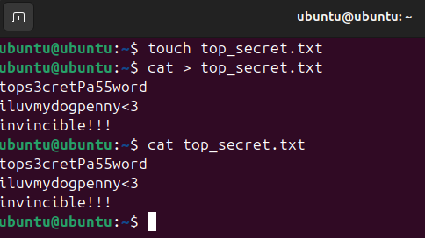
Account Permissions
This line creates our file
Here, we are entering in any values to our file
To exit cat, press ctrl+D
This line has the system list what is in the file so that we know we did the above command correctly

Slide 21
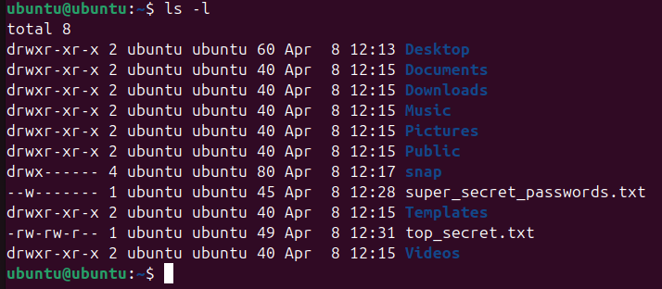
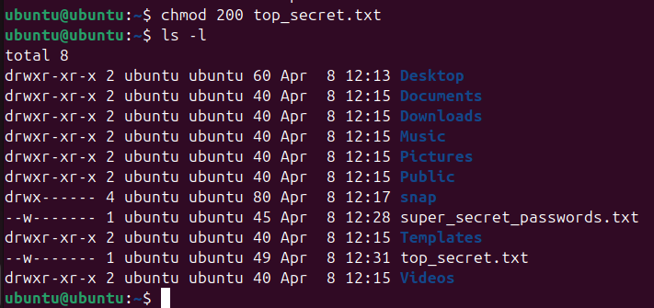
Account Permissions
Here, I used ls –l to generate a long list of the files and directories that I have in my virtual machine. As you can see, all of the permissions are shown.
After we use chmod on our top_secret.txt folder, the permissions have been changed to where only the owner can write to it.
Bonus Knowledge! All of the directories permissions start with a ‘d’ to indicate that they’re a directory. The names of them are also in blue.

Slide 22


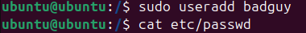

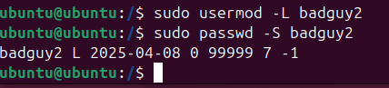
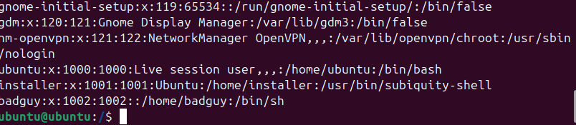
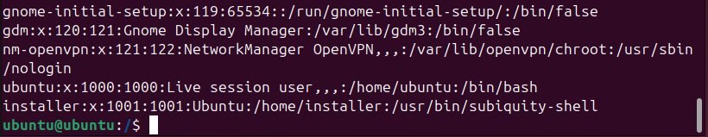
Delete/Disable Admin & Guests
Delete
Disable
Syntax: sudo userdel <user>
Syntax: sudo usermod –L <user>
Here, I went in and created a user named badguy2
Then I used usermod with the –L flag to lock the account. To show that the account was locked, I typed sudo passwd –S badguy2
The L in the return statement means account is locked
Before After

Slide 23
How to force a user to change their password:
This one is super simple! All you have to type in your terminal is:
passwd –e <username>
This will ensure that the user has to change their password which is a good practice if their password has been compromised

Slide 24
Quiz!
Write down your answers and
check the answer key at the end

Slide 25



Question 1
What do the 3 fields in account permissions stand for?
Admin, user, others
Owner, group, others
Sudo, users, others

Slide 26
Question 2
What permissions does a file/directory have if its set to 655?
rwx
r-x
r-x
r-x
rwx
--x
C

Slide 27
Question 2
What does –r do when removing a user
Rewrites the user
Recursively deletes user
Puts user in rest mode

Slide 28
Question 2
What is the correct syntax for deleting a user?
sudo userdel <user>
Sudo deluser <user>
userdel <user>

Slide 29

Answer Key
Question 1
Owner, group, others
Question 2
rw-, r-x, r-x
Question 3
Recursively deletes user
Question4
sudo userdel <user>

Slide 30
Addtl. Resources
Remember that bonus info on what –r means? Learn more about what recursion means in computer science terms:
https://www.youtube.com/watch?v=YZcO_jRhvxs
Curious about other vulnerabilities? Check out the National Vulnerability Databse website for recent and old ones!
https://nvd.nist.gov/

Slide 31



THANK
YOU!

